Slide 1
S3: Probability Distributions
Statistical Methods for Decision Making

Slide 3
Doubts in previous session

Slide 4
Agenda
Random Variable and its types
Probability Distributions
Discrete Probability Distribution
Binomial
Poisson
Continuous Probability Distribution
Normal

Slide 5
Random Variable
A variable is random if it takes on different values as result of the outcomes of a random experiment or is an experiment with random outcome.
Random variable is a variable related to a random event.
A random variable is discrete if it has a finite or countable number of possible outcomes that can be listed.
A random variable is Continuous if it has an uncountable number or possible outcomes within a given interval.

Slide 6
Types of Random Variable
Discrete Random variable
Continuous Random Variable
If a random variable is allowed to take only limited number of values, which can be listed, it is a discrete random variable.
A discrete random variable can assume only finite number of numerical values.
Eg: Number of students in statistics class.
If the RV is allowed to assume any value within a given range/interval, then it is a continuous random variable
A continuous random variable can assume infinite number of numerical values. These experimental outcomes are based on interval or ratio scale.
Eg: Waiting time for customer in ATM queue.

Slide 7
Random Variable Example
Breast cancer screening clinic, there is no way of know exactly how many women will be screened on any one day.
Tomorrow's number of patients is a random variable , and the values of the random variable are numerical assignments to each possible outcome of the random experiment.
As per the past records, if the daily number of patients ranges between 100 to 115, then the random variable is a discrete random variable.
Average waiting time taken for a patient to get screened is a continuous random variable.

Slide 8
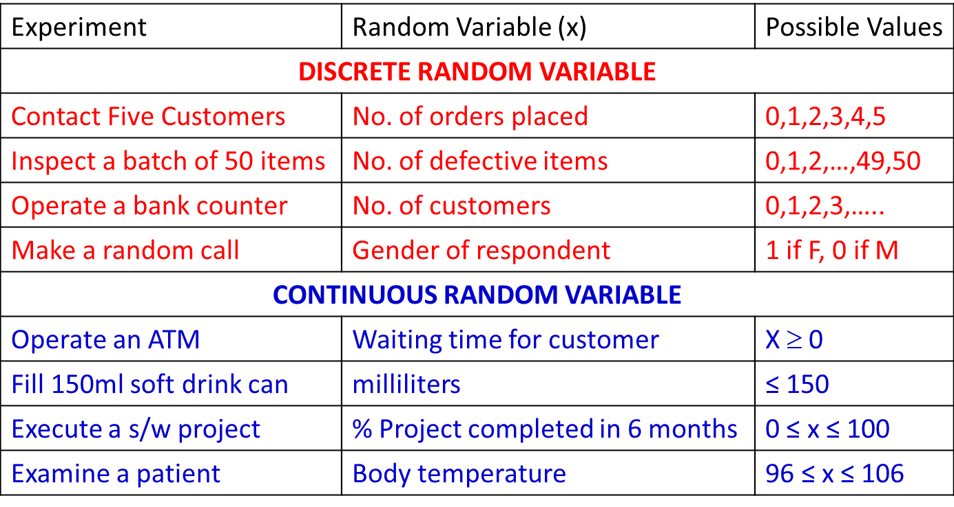
Random Variable – More Examples

Slide 9
Probability Distribution
A probability distribution of a random variable X is a description of the probabilities associated with the possible values of X.

Slide 10
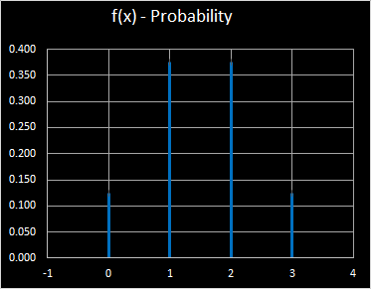
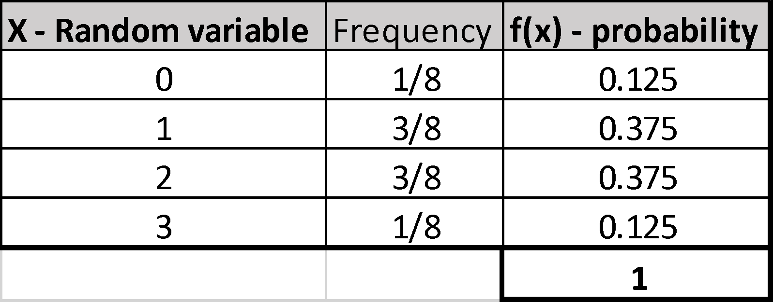
Probability distributions – Coin Toss Example
X = Number of heads after 3 flips of a fair coin
# of Heads in 3 flips of coin
HHH
HTH
HTT
HTH
HTT
HHT
TTH
TTT

Slide 12
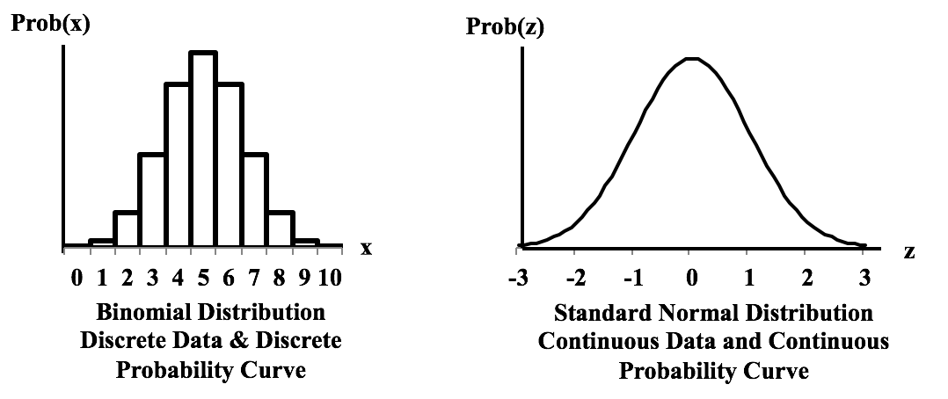
Types of Probability Distributions
Discrete Probability Distribution
Continuous Probability Distributions

Slide 13
Discrete Probability Distribution

Slide 14
Discrete Probability Distribution
A probability distribution for a random variable describes how probabilities are distributed for different values assumed by the random variable.
It is a mutually exclusive list of all the possible numerical outcomes along with the probability of occurrence of each outcome.
Mean or Expected value of a discrete random variable
E(x) = μ = Σ xf(x)
Variance of a discrete random variable
Var(x) = σ² = Σ (x- μ)²f(x)

Slide 15
Probability Mass Function (PMF)
The probability distribution for a discrete random variable is described with a probability mass function

Slide 16
Rules for Discrete Probability Distribution or PMF – Example 1
[x ,f(x)] is said to constitute Probability Distribution if :
x is a random variable
f(x) > = 0
Σf(x) = 1
Data which satisfies this rules is a valid Probability distribution.
# of Heads in 3 flips of coin
HHH
HTH
HTT
HTH
HTT
HHT
TTH
TTT

Slide 18
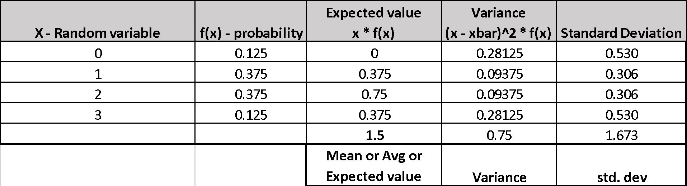
Calculate Expected value and Variance
Mean or Expected value of a discrete random variable
E(x) = μ = Σ xf(x)
Variance of a discrete random variable
Var(x) = σ² = Σ (x- μ)²f(x)

Slide 19
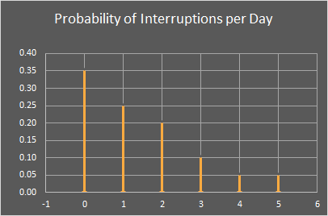
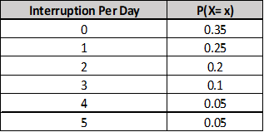
Discrete Probability Distribution – Example 2
Distribution of the number of interruptions per day in a large computer network.

Slide 21
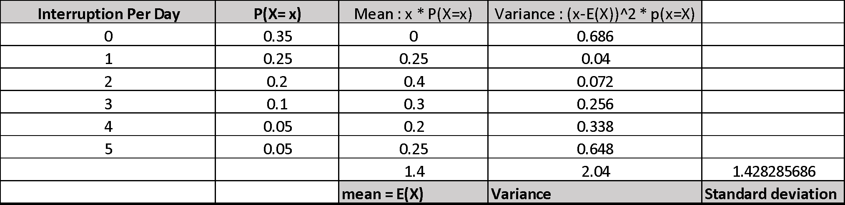
Discrete Probability Distribution – Expectation and Variance Calculation
Distribution of the number of interruptions per day in a large computer network
Mean or Expected value of a discrete random variable
E(x) = μ = Σ xf(x)
Variance of a discrete random variable
Var(x) = σ² = Σ (x- μ)²f(x)

Slide 23
Cumulative Distribution Function – CDF :
The cumulative distribution function (CDF) of a random variable is another method to describe the distribution of random variables.
The advantage of the CDF is that it can be defined for any kind of random variable (discrete, continuous)

Slide 24
Cumulative distribution function (CDF)
x
P(x ≤ A)
P(x)
1.0
1
P(x ≤ 1) =1/6
5/6
2
P(x ≤ 2) =2/6
2/3
3
P(x ≤ 3) =3/6
1/2
1/3
4
P(x ≤ 4) =4/6
1/6
5
P(x ≤ 5) =5/6
1
2
3
4
5
6
x
6
P(x ≤ 6) =6/6

Slide 25
Discrete Probability Distribution
Binomial
Poisson

Slide 26
Binomial Distribution

Slide 27
Binomial Distribution
Is a discrete probability distribution.
It is a multistep experiment.
Properties (or assumptions) of binomial experiment:
The experiment consists of a sequence on n trials.
Only two outcomes are possible in each trial. We refer to one of them as “success” and the other as “failure”.
The probability of success is denoted by p, does not change from trial to trial.
The probability of failure is given by (1-p) as a consequence of above.
The trials are independent.

Slide 28
Binomial Distribution – Business Examples
How many of the customers visiting a supermarket make a purchase?
How many calls of an insurance agent will result in subscription?
How many purchases will be made using credit card?

Slide 29
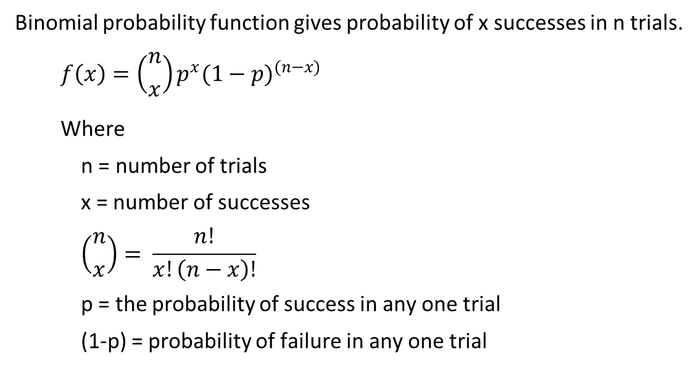
Binomial Probability Function

Slide 30
Mean and Variance of Binomial Distribution
A binomial experiment is a series of n Bernoulli trials. Therefore
μx = p + p + … n times = np
Let (1-p) = q then
For a Bernoulli trial
Var(b) = pq
For n trials
Var(x) = pq + pq + … n times = npq = np(1-p)

Slide 31
Binomial - Martin Cloth store problem
On the basis of past experience Martin Cloth Store manager estimates that the probability of purchase by any customer is 0.3 and purchase decision of one customer does not influence the other.
What is the probability of 2 of the next 3 customers will make a purchase?

Slide 33
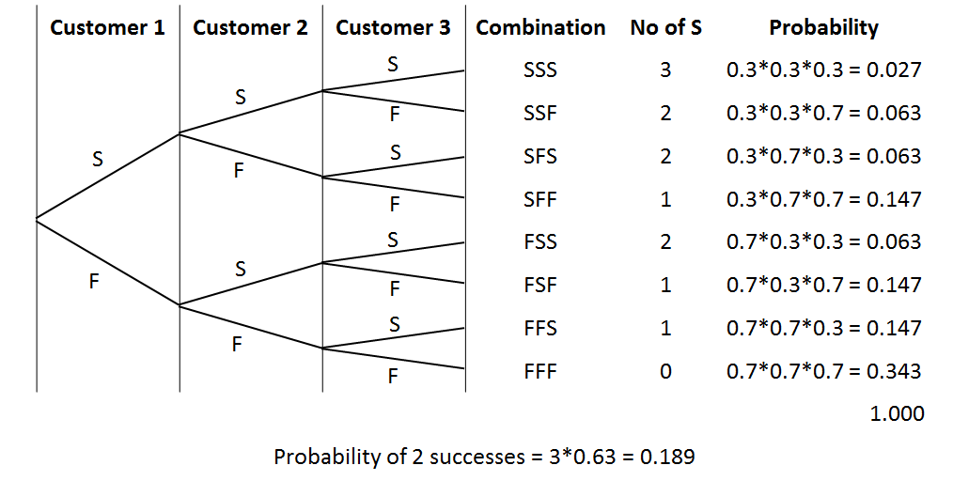
Binomial - Martin Cloth Store problem
3 *P^2 * (1-p)

Slide 34
Poisson Distribution

Slide 35
Poisson Distribution
A probability Distribution that is used to estimating number of occurrences over a specified interval of time or space.
Properties of Poisson Probability Function
The probability of occurrence is same in two intervals of same length.
The probability of occurrence or non-occurrence is independent of occurrence or non-occurrence in any other interval.

Slide 36
Poisson Distribution – Business Examples
No. of persons arriving at a service station or ATM.
No. of calls coming to a call center in a given interval.
No. of defects in a length of cloth from a loom.
No. of accidents in a given length of highway.

Slide 37
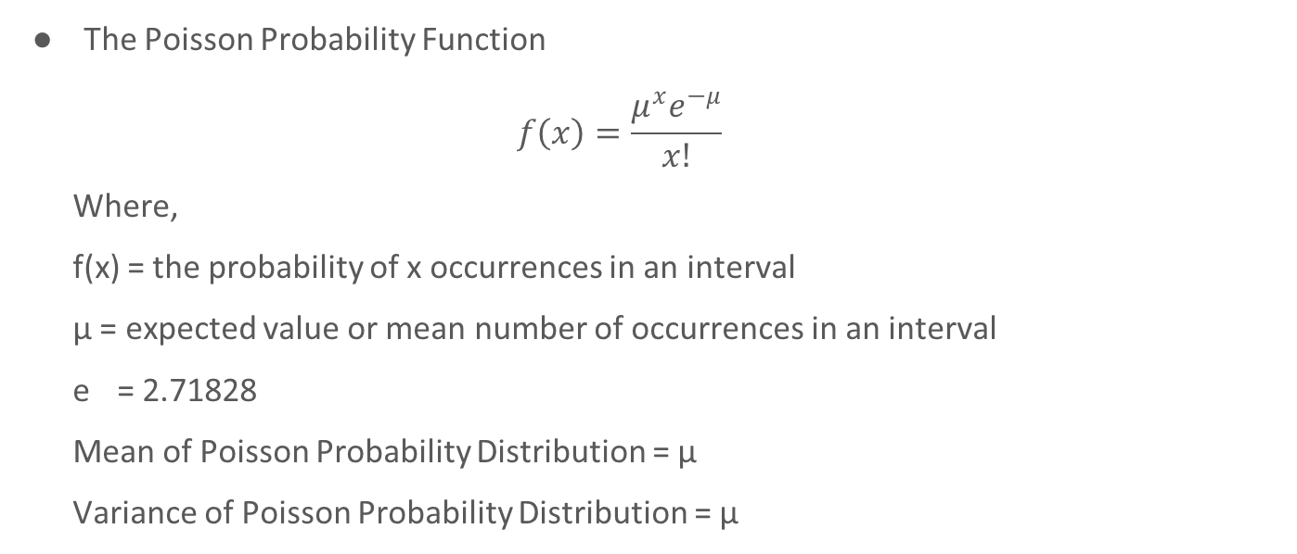
Poisson Probability Function

Slide 38
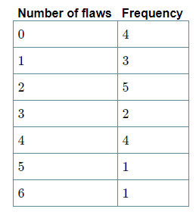
Poisson Distribution – Example 1
Twenty sheets of aluminum alloy were examined for surface flaws. The frequency of the number of sheets with a given number of flaws per sheet was as follows:
What is the probability of finding a sheet chosen
at random which contains 3 or more surface flaws?

Slide 40
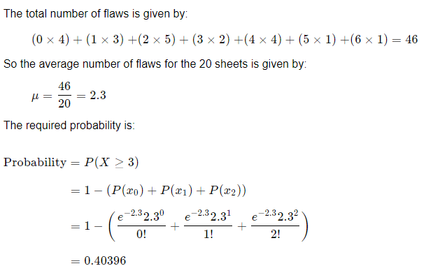
Poisson Distribution – Example 1 with solution

Slide 41
Poisson Distribution – Example 2
Vehicles pass through a junction on a busy road at an average rate of 300 per hour.
Find the probability that none passes in a given minute.
What is the expected number passing in two minutes?
Find the probability that this expected number actually pass through in a given two-minute period.

Slide 42
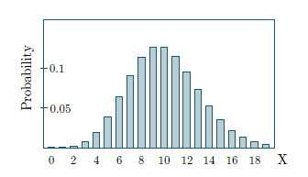
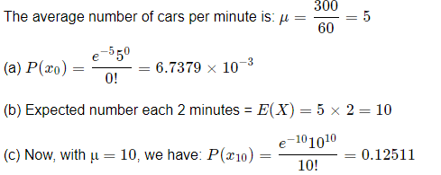
Poisson Distribution – Example 2 Solution

Slide 44
Continuous Probability Distribution

Slide 45
Continuous Probability Function
Assume that to come to this class you travel for 45mins to 1 hour. If your travel time is a random variable it may take value between 45 and 60 including decimal values.
So the travel time is a continuous random variable. All the random variables measured on interval and ratio scale are continuous random variables.
For a continuous random variable
The probability at any point is 0. (Area under curve only makes sense)
Only probabilities exist for intervals. We do not talk about probability of RV assuming particular value. We talk about probability for a given interval.
The cumulative probability is equal to 1 i.e. sample space.
The probability density can never be negative.
The probability density can exceed 1.
Area is a measure of probability.

Slide 46
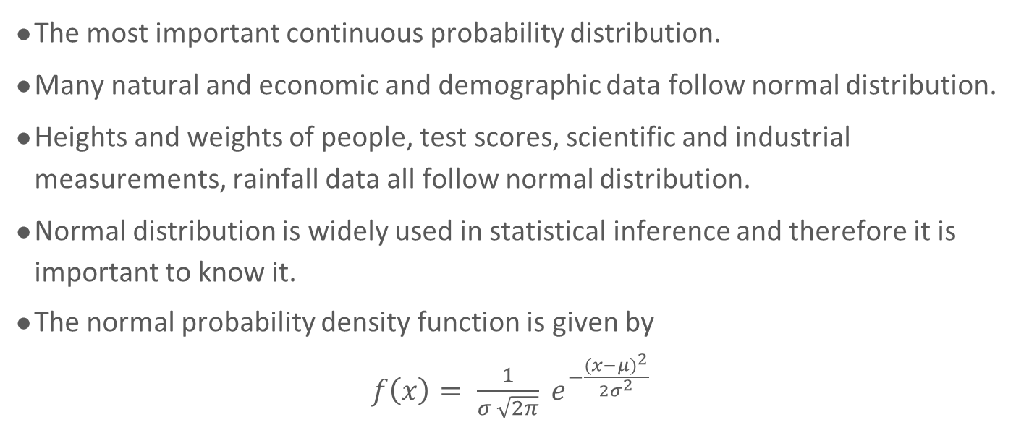
Normal Distribution

Slide 47
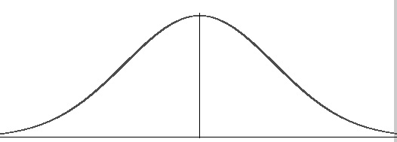
Normal Probability Distribution
The entire family of normal probability distributions is differentiated by its mean and standard deviation.
The highest point of the distribution is the mean which is also the median and mode of the distribution.
The mean can be any numeral +ve, 0 or -ve.
Normal distribution is symmetric on y axis, bisected by mean.
The tails of the curve extend to infinity.
Standard deviation σ
x
mean

Slide 48
Normal Probability Distribution
x
-10
-0
10
Same standard deviation different means
Standard deviation σ = 5
Standard deviation σ = 10
x
0
Same mean different standard deviations

Slide 50
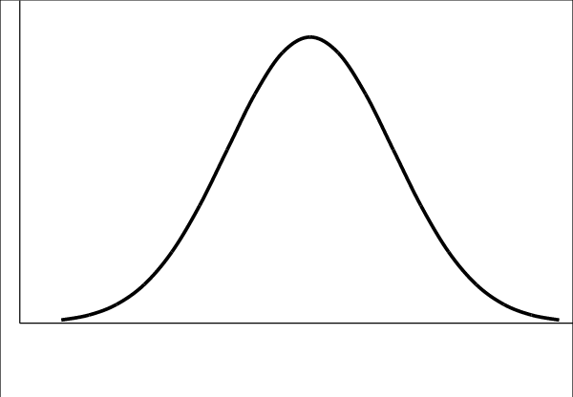
The Normal Curve
68%
95.5%
99.75%
-3σ
-2σ
-1σ
μ
1σ
2σ
3σ

Slide 51
Normal distribution table
z | 0.00 | 0.01 | 0.02 | 0.03 | 0.04 | 0.05 | 0.06 | 0.07 | 0.08 | 0.09
0.0 | .0000 | .0040 | .0080 | .0120 | .0160 | .0199 | .0239 | .0279 | .0319 | .0359
0.1 | .0398 | .0438 | .0478 | .0517 | .0557 | .0596 | .0636 | .0675 | .0714 | .0753
0.2 | .0793 | .0832 | .0871 | .0910 | .0948 | .0987 | .1026 | .1064 | .1103 | .1141
0.3 | .1179 | .1217 | .1255 | .1293 | .1331 | .1368 | .1406 | .1443 | .1480 | .1517
0.4 | .1554 | .1591 | .1628 | .1664 | .1700 | .1736 | .1772 | .1808 | .1844 | .1879
0.5 | .1915 | .1950 | .1985 | .2019 | .2054 | .2088 | .2123 | .2157 | .2190 | .2224
0.6 | .2257 | .2291 | .2324 | .2357 | .2389 | .2422 | .2454 | .2486 | .2517 | .2549
0.7 | .2580 | .2611 | .2642 | .2673 | .2704 | .2734 | .2764 | .2794 | .2823 | .2852
0.8 | .2881 | .2910 | .2939 | .2967 | .2995 | .3023 | .3051 | .3078 | .3106 | .3133
0.9 | .3159 | .3186 | .3212 | .3238 | .3264 | .3289 | .3315 | .3340 | .3365 | .3389
1.0 | .3413 | .3438 | .3461 | .3485 | .3508 | .3531 | .3554 | .3577 | .3599 | .3621
1.1 | .3643 | .3665 | .3686 | .3708 | .3729 | .3749 | .3770 | .3790 | .3810 | .3830
1.2 | .3849 | .3869 | .3888 | .3907 | .3925 | .3944 | .3962 | .3980 | .3997 | .4015
1.3 | .4032 | .4049 | .4066 | .4082 | .4099 | .4115 | .4131 | .4147 | .4162 | .4177
1.4 | .4192 | .4207 | .4222 | .4236 | .4251 | .4265 | .4279 | .4292 | .4306 | .4319
1.5 | .4332 | .4345 | .4357 | .4370 | .4382 | .4394 | .4406 | .4418 | .4429 | .4441
1.6 | .4452 | .4463 | .4474 | .4484 | .4495 | .4505 | .4515 | .4525 | .4535 | .4545
1.7 | .4554 | .4564 | .4573 | .4582 | .4591 | .4599 | .4608 | .4616 | .4625 | .4633
1.8 | .4641 | .4649 | .4656 | .4664 | .4671 | .4678 | .4686 | .4693 | .4699 | .4706
1.9 | .4713 | .4719 | .4726 | .4732 | .4738 | .4744 | .4750 | .4756 | .4761 | .4767
2.0 | .4772 | .4778 | .4783 | .4788 | .4793 | .4798 | .4803 | .4808 | .4812 | .4817
2.1 | .4821 | .4826 | .4830 | .4834 | .4838 | .4842 | .4846 | .4850 | .4854 | .4857
2.2 | .4861 | .4864 | .4868 | .4871 | .4875 | .4878 | .4881 | .4884 | .4887 | .4890
2.3 | .4893 | .4896 | .4898 | .4901 | .4904 | .4906 | .4909 | .4911 | .4913 | .4916
2.4 | .4918 | .4920 | .4922 | .4925 | .4927 | .4929 | .4931 | .4932 | .4934 | .4936
2.5 | .4938 | .4940 | .4941 | .4943 | .4945 | .4946 | .4948 | .4949 | .4951 | .4952
2.6 | .4953 | .4955 | .4956 | .4957 | .4959 | .4960 | .4961 | .4962 | .4963 | .4964
2.7 | .4965 | .4966 | .4967 | .4968 | .4969 | .4970 | .4971 | .4972 | .4973 | .4974
2.8 | .4974 | .4975 | .4976 | .4977 | .4977 | .4978 | .4979 | .4979 | .4980 | .4981
2.9 | .4981 | .4982 | .4982 | .4983 | .4984 | .4984 | .4985 | .4985 | .4986 | .4986
3.0 | .4987 | .4987 | .4987 | .4988 | .4988 | .4989 | .4989 | .4989 | .4990 | .4990

Slide 52
Probability Calculations using Normal Curve
Using standard normal distribution we can find out probability that z assumes certain value.
z | Area = Probability
< 1 | 0.3413 + 0.5 = 0.8413
> 2 | 0.5000 – 0.4772 = 0.0228
1 < z < 2 | 0.4772 – 0.3413 = 0.1359
< -2 | = > +2 = 0.5000 – 0.4772 = 0.0228
-1 < z < -0.5 | = 0.5 < z < 1 = 0.3413 – 0.1915 = 0.1498
-1 < z < 1.5 | = z < 1 + z < 1.5 = 0.3413 + 0.4332 = 0.7745

Slide 53
Hands-on
Case study

